Slide 1

Project Presentation Topics in WIRELESS COMMUNICATIONS ( COMP-5413) Instructor: Dr. Dariush Ebrahimi Simulation of Realistic Vehicular Ad-Hoc (Vanet) Network using SUMO Project Members: Abhishek Nagrecha, Rajesh Aytha Sagar Deshpande, Abhigya Koirala, Jeevan Reddy Gopu

Slide 2
Project topic- Vanets
VANETs are a subset of MANETs (Mobile Ad-hoc Networks) in which cars are essentially contact nodes.
VANET transforms any vehicle into a wireless node, allowing cars that are 100-200 meters away to link to one another and build a large variety of networks in turn.
various types of VANET configurations are dissemination of the V2V alert. Communication of the V2V community, beaconing of V2V,I2V / V2I alert.
most significant purpose of VANETs is to help safety applications in which each vehicle regularly broadcasts safety signals.

Slide 3
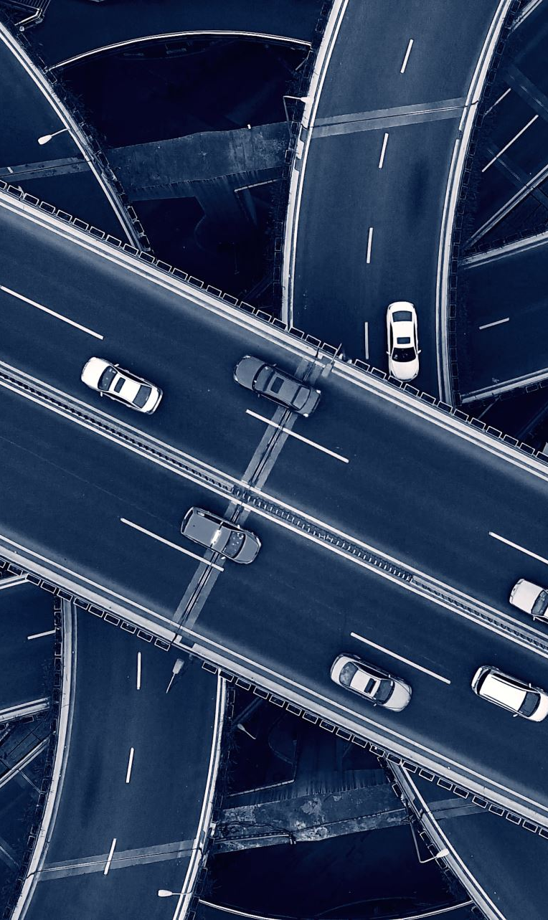
Vanet’s Architecture
There are three different types of communications that occur in Vanets:
Vehicle to vehicle communication(V2V)- Allows vehicles to exchange data . Short communications. Detects unsafe traffic conditions. Prevents collisions.
Vehicle to infrastructure communication-gathers information like traffic congestion, weather warnings, rate of bridge clearance, and then transmits it wirelessly to alert drivers of the situations. V2I powered traffic signals predicts traffic patterns.
Vehicle-to-Everything (V2X): Combination of above two. It makes any vehicle on the road smarter and safer by warning drivers about adverse weather situations, local injuries and traffic congestion etc.

Slide 4
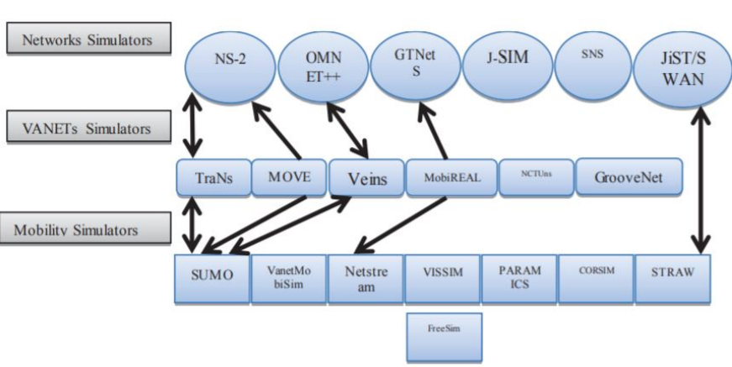
Categories of vanet simulators

Slide 5

Routing Protocols in VANET

Slide 6

1) Position Based Routing Protocols :
These can find a path to the destination depending on the physical location of the nodes. For e.g., the Geographic Source routing (GSR) protocol uses a big map to locate a path from source to destination.
2) Reactive Routing Protocols :
These only implement path computation on a demand-based basis, so that they provide better performance than constructive routing protocols. For e.g., the Ad hoc On Demand Distance Vector (AODV) defines the path to the destination on demand.
3) Proactive Routing Protocols :
These often establish routes from source to destination by reviewing the routing table on a regular basis. Optimized Link state routing (OLSR) stores the entire route from source to destination.

Slide 7
TDMA
Time Division Multiple Access (TDMA) is a channel access system where time divisions are split into the available bandwidth and each section is only used by a single sender, eliminating packet collisions.
Due to the lack of unified control and high slot allocation difficulty, TDMA, however, requires modifications to be used in ad-hoc networks. To maintain slot synchronization and to decrease overhead messages[

Slide 8

System Model and Problem Definition
In this work, we propose a VANET model using TDMA as an access medium to transmit the data into various resource blocks.
Our objective is to maximize the amount of transmitted data in the vehicular network.
We will be running our network simulations using Veins, in which SUMO, a road traffic simulator, is paired with other event-based network simulator OMNET++
So we use the TDMA principle that helps allocating the bandwidth to different vehicles by distributing time into different frames where each frame is divided into different time slots.
where the 3 subset of time slots will be reused, ensuring no vehicles in different adjacent areas can access the channel at the same time and thus no interference will occur

Slide 9
SuMO Simulator
It facilitates the simulation of how a given demand for traffic composed of vehicles passes across a given road network
SUMO is not only a traffic simulator, but a series of programs that help to plan and execute a traffic simulation.
The role of SUMO in enabling users to import road networks has streamlined the process of designing the mobility model.
Can create SUMO road networks by using a tool called ”netgen” or by importing a digital road map
Most popular applications for SUMO are simulation of traffic in V2X-vehicle-to -vehicle and vehicle-to-infrastructure communication analysis.

Slide 10
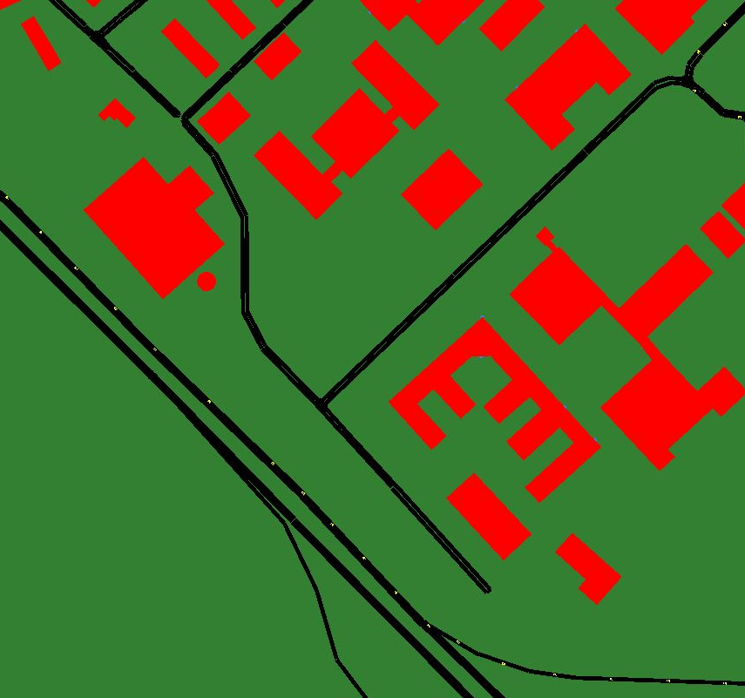
Sumo simulator (contd.)
A suitable area was taken into consideration for our model.
The Figure , shows the part of road network which has 194 nodes .
Next, the vehicles will be clustered into groups “The problem here is to reduce the amount of data collision and increase data transfer.”

Slide 11

About the road structure:
SUMO makes it easy for users to import road networks which leads to designing the mobility model.
The real-world road network can be easily extracted and edited using the Java Open Street Map (JOSM) Editor.
The part of the map is selected in such a way that multi-lane roads and highways are also taken into consideration.
Vehicles are dynamic and map was further processed by sumo network to generate heuristically computed values.

Slide 12
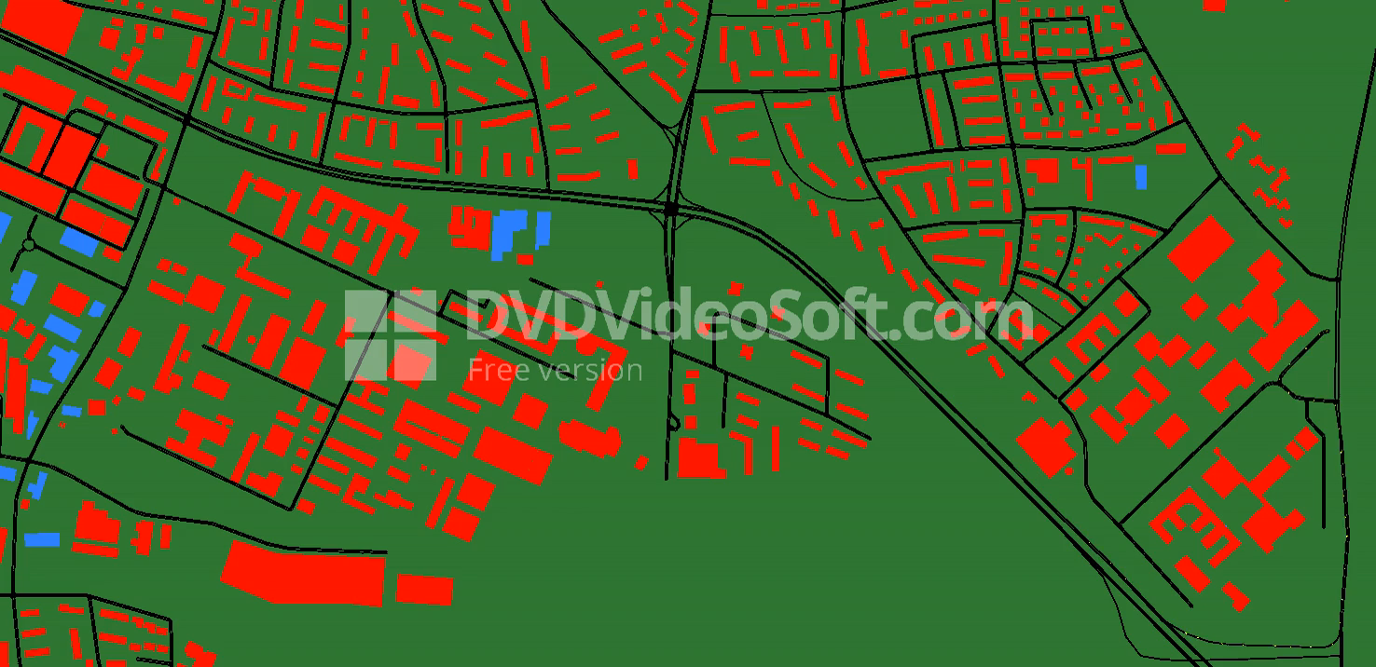
mobility Simulation

Slide 13
Problem formulation-Hybrid Approach
Network connectivity simulator plays a key role when having a large network with vehicles.
We are considering Veins, a hybrid simulation platform focused on long-established SUMO and OMNET++, in the quest for user satisfaction and inter-connectivity.
We selected Java Open Street Map (JOSM) as our GUI and editor for OSM maps.
Both the simulators were linked by TCP socket which means that the cars are first produced in SUMO and then transferred to the network simulator. OMNET++ finds all vehicles to be nodes and simulates the situation.

Slide 14
Veins simulator
Features
Advantages
Online Reconfiguration.
Re-routing of vehicles.
Wide Range of Metrics are utilized in Veins simulator.
Fully detailed models of IEEE 802.11p.
Trusted Vehicular Mobility Model.
Flexibility.
Acceptable Simulator.
Also Active community with support.
Provide integrated solution.
Nodes can be freely interacted with the running road traffic simulation.

Slide 15
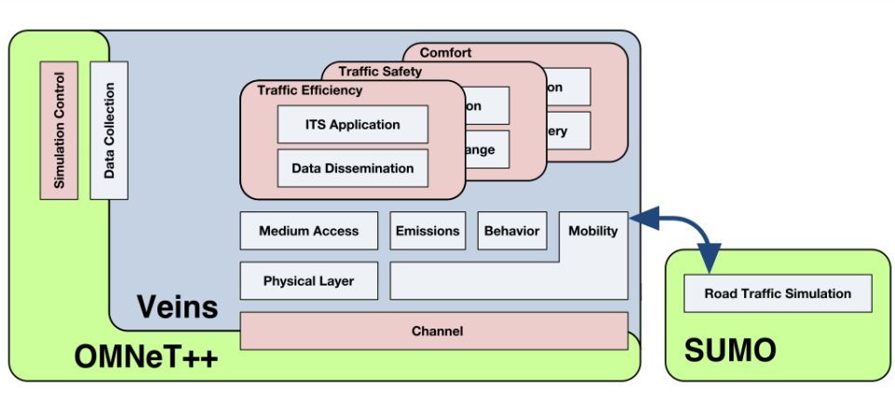
Veins architecture

Slide 16
Problem formulation
Next, If there is some alteration in the network, Veins will switch the SUMO car scenario.
Veins switches the SUMO car scenario, and it has a wide range of simulations in it for our usage.This protocol is known as Traffic Control Interface (TraCI).
Velocity of the cars, route switching, and actions of traffic lights can be altered by calling the veins TraCi unit as it allows to retrieve values of simulated objects and to manipulate their behavior "on-line"

Slide 17
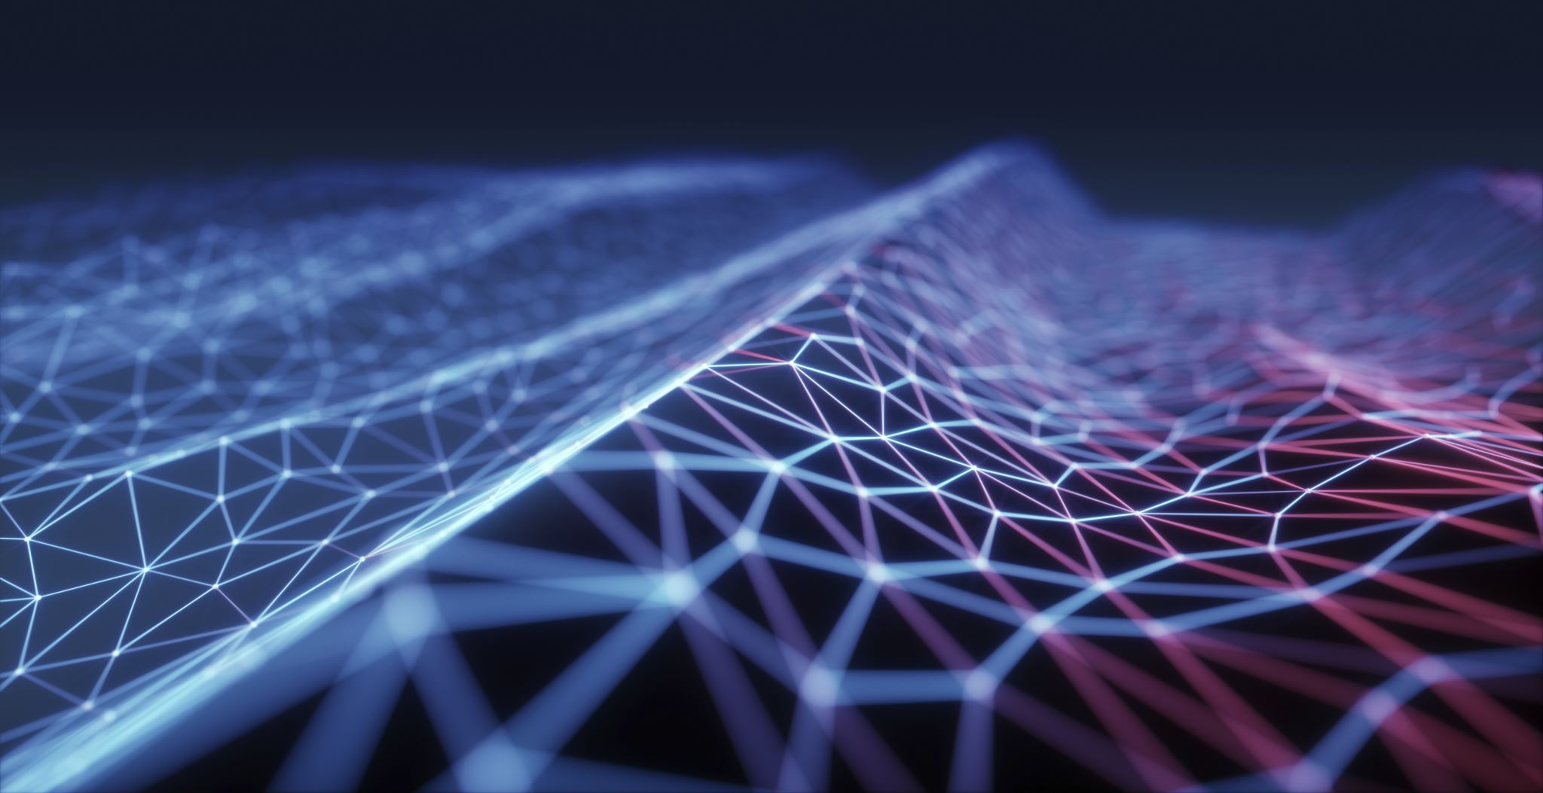
Network simulation

Slide 18
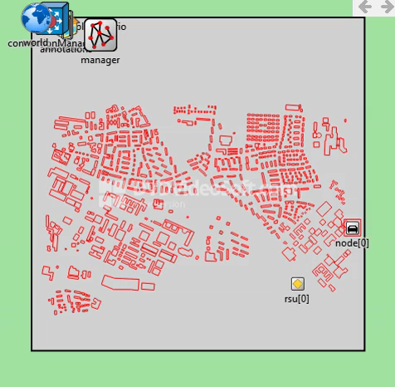
Our Network Simulation in omnet++

Slide 19
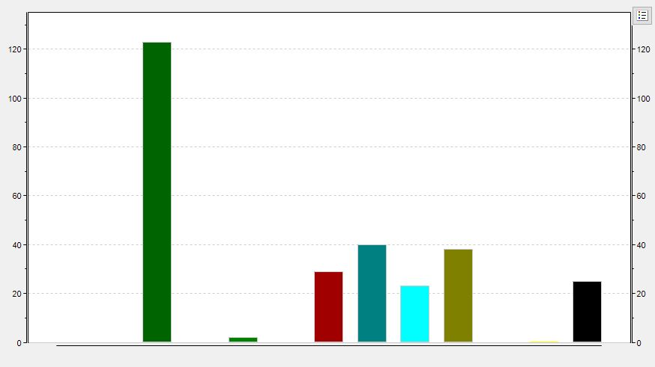
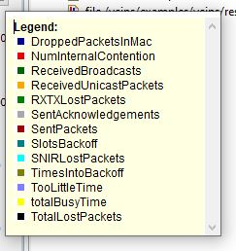
Results- rsu

Slide 20
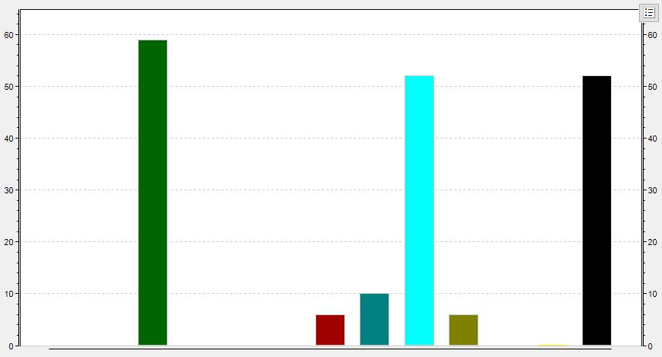
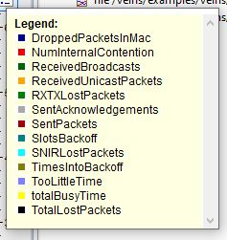
Results for a node

Slide 21
Future works
We are considering to implement hybrid techniques for better results.
We will be experimenting with different road map structures in SUMO, since currently we have used the default version.
Filter out the required data to improve the results.

Slide 22
Conclusion
For the simulation of VANET we decided to use the Veins simulation platform along with SUMO and OMNET++.
Additionally we explored the working of JOSM editor and different commands related to the simulator.
Our primary aim is to define a model which maximizes the amount of transmitted data in the vehicular network while considering the transmission fairness among all pair of vehicles.

Slide 23

Thank you

